Slide 1
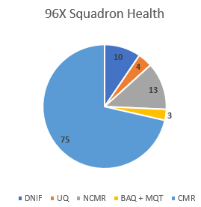
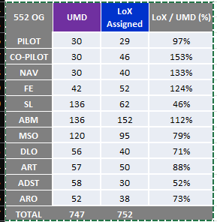
⌖
INSIGHT
READINESS TRACKER
CURRENT SYS
INSIGHT’S
GOALS
Current sys used by 552 OG built in Excel
Primary maintainer of application PCS’d
Single Point of Failure
Limitations by Excel
Data inconsistencies/errors required difficult excel commands, hard to maintain
Relies on schema to be exact
Tracked data was specific to OG
Not every unit has the same requirements
However, application was very dense and detailed.
Combine readiness data into one location
Alpha Roster
LOXs (PEX)
ETMS (MyLearning)
AEF
SFIMS (ARIS)
Previously, TBA
Reclaim time from UTMs/UDMs/Unit Leadership
Track Deployment Phases
Integrate more sources, modular

Slide 2
CURRENT SYS
INSIGHT’S
GOALS
Current sys used by 552 OG built in Excel
Primary maintainer of application PCS’d
Single Point of Failure
Limitations by Excel
Data inconsistencies/errors required difficult excel commands, hard to maintain
Relies on schema to be exact
Tracked data was specific to OG
Not every unit has the same requirements
However, application was very dense and detailed.
Combine readiness data into one location
Alpha Roster
LOXs (PEX)
ETMS (MyLearning)
AEF
SFIMS (ARIS)
Previously, TBA
Reclaim time from UTMs/UDMs/Unit Leadership
Track Deployment Phases
Integrate more sources, modular

Slide 3
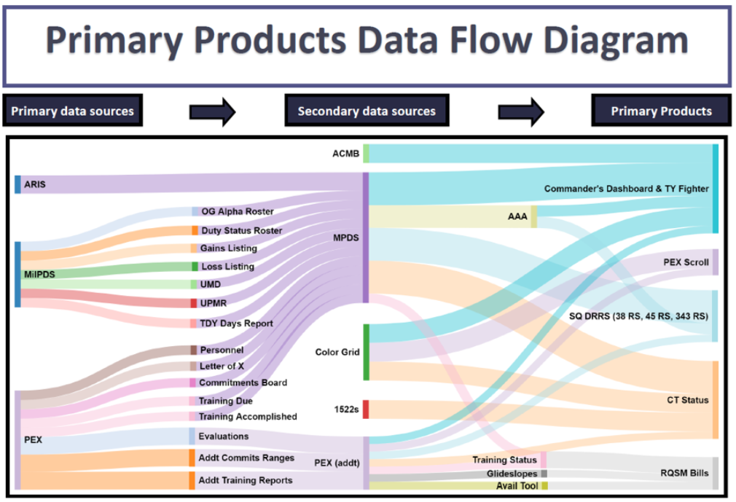
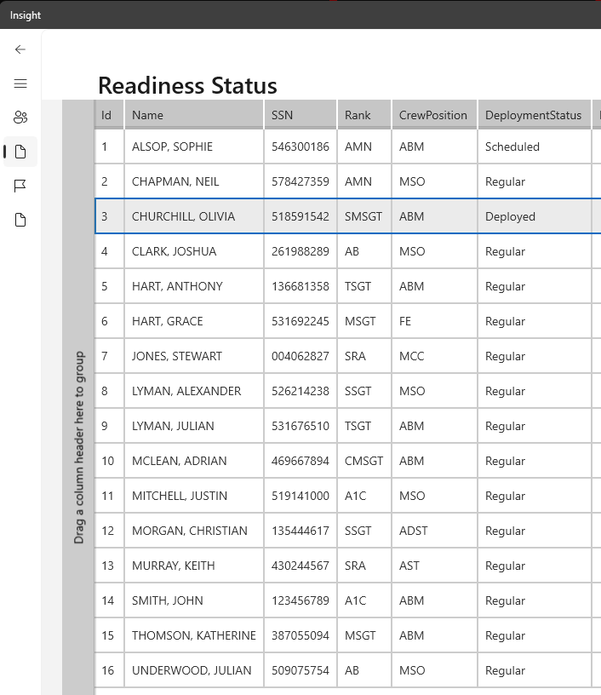
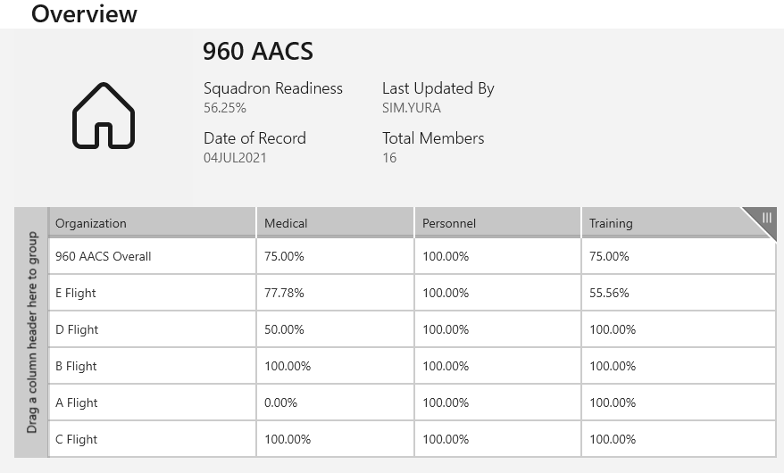
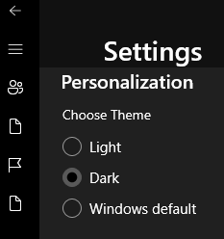
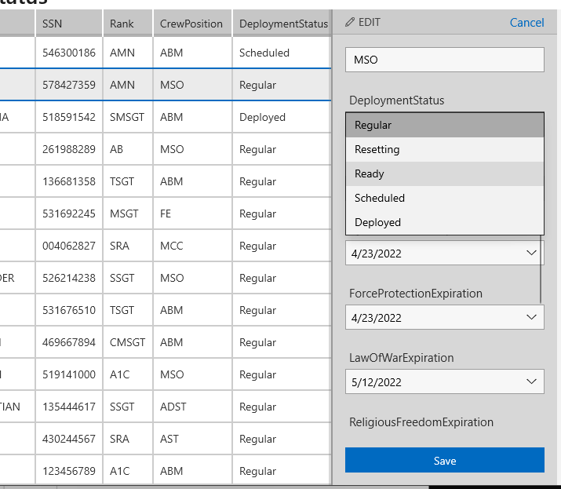
IMPLEMENTED SOLUTIONS
Local data storage solution
Cheap
Less difficult to store PII
Requires host wing approval
SQL Database requires migration code
Processes/ingests multiple data sources into central system (EFC)
EFC is more maintainable than excel
Smart-Sense file type detection system
Doesn’t care about location or name of file
Supported by multiple members
Eliminated SPOF
Name Detection Queries
Mitigates name ambiguity
Sorting, Filtering,
Unit Statistics
Overall Readiness
Medical Readiness
Training Readiness
Saves user deployment statuses
Clean Windows-Like UI
FUTURE
Process more files
PEX
MILPDS
UI improvements
Freshness Data
Automatic Updates (API)
Crew Building Tool

Slide 4

IMPLEMENTED SOLUTIONS
Local data storage solution
Cheap
Less difficult to store PII
Requires host wing approval
SQL Database requires migration code
Processes/ingests multiple data sources into central system (EFC)
EFC is more maintainable than excel
Smart-Sense file type detection system
Doesn’t care about location or name of file
Supported by multiple members
Eliminated SPOF
Name Detection Queries
Mitigates name ambiguity
Sorting, Filtering,
Unit Statistics
Overall Readiness
Medical Readiness
Training Readiness
Saves user deployment statuses
Clean Windows-Like UI
FUTURE
Process more files
PEX
MILPDS
UI improvements
Freshness Data
Automatic Updates (API)
Crew Building Tool
DEPLOYMENT
Deployment options
Local Computer (Dev Laptop) w/o NIPR Access
Requires customer to transfer data via CD
Doesn’t require interim approval
Can be delivered by next week
AO in host Wg
Sim is in contact w/ 72 Wg cybersecurity through auxiliary projects
Can deliver hosting procedures
Migrate to Web
Host via VxRails?
Either React Native / Uno Proj / MAUI / Flutter
Benefits to #3
Same Tech Stack to Mobile Team
Xamarin is deprecating
Interchangeable Teams
Same Training (Xamarin is different than MAUI)
Flexibility on target platform

Slide 5
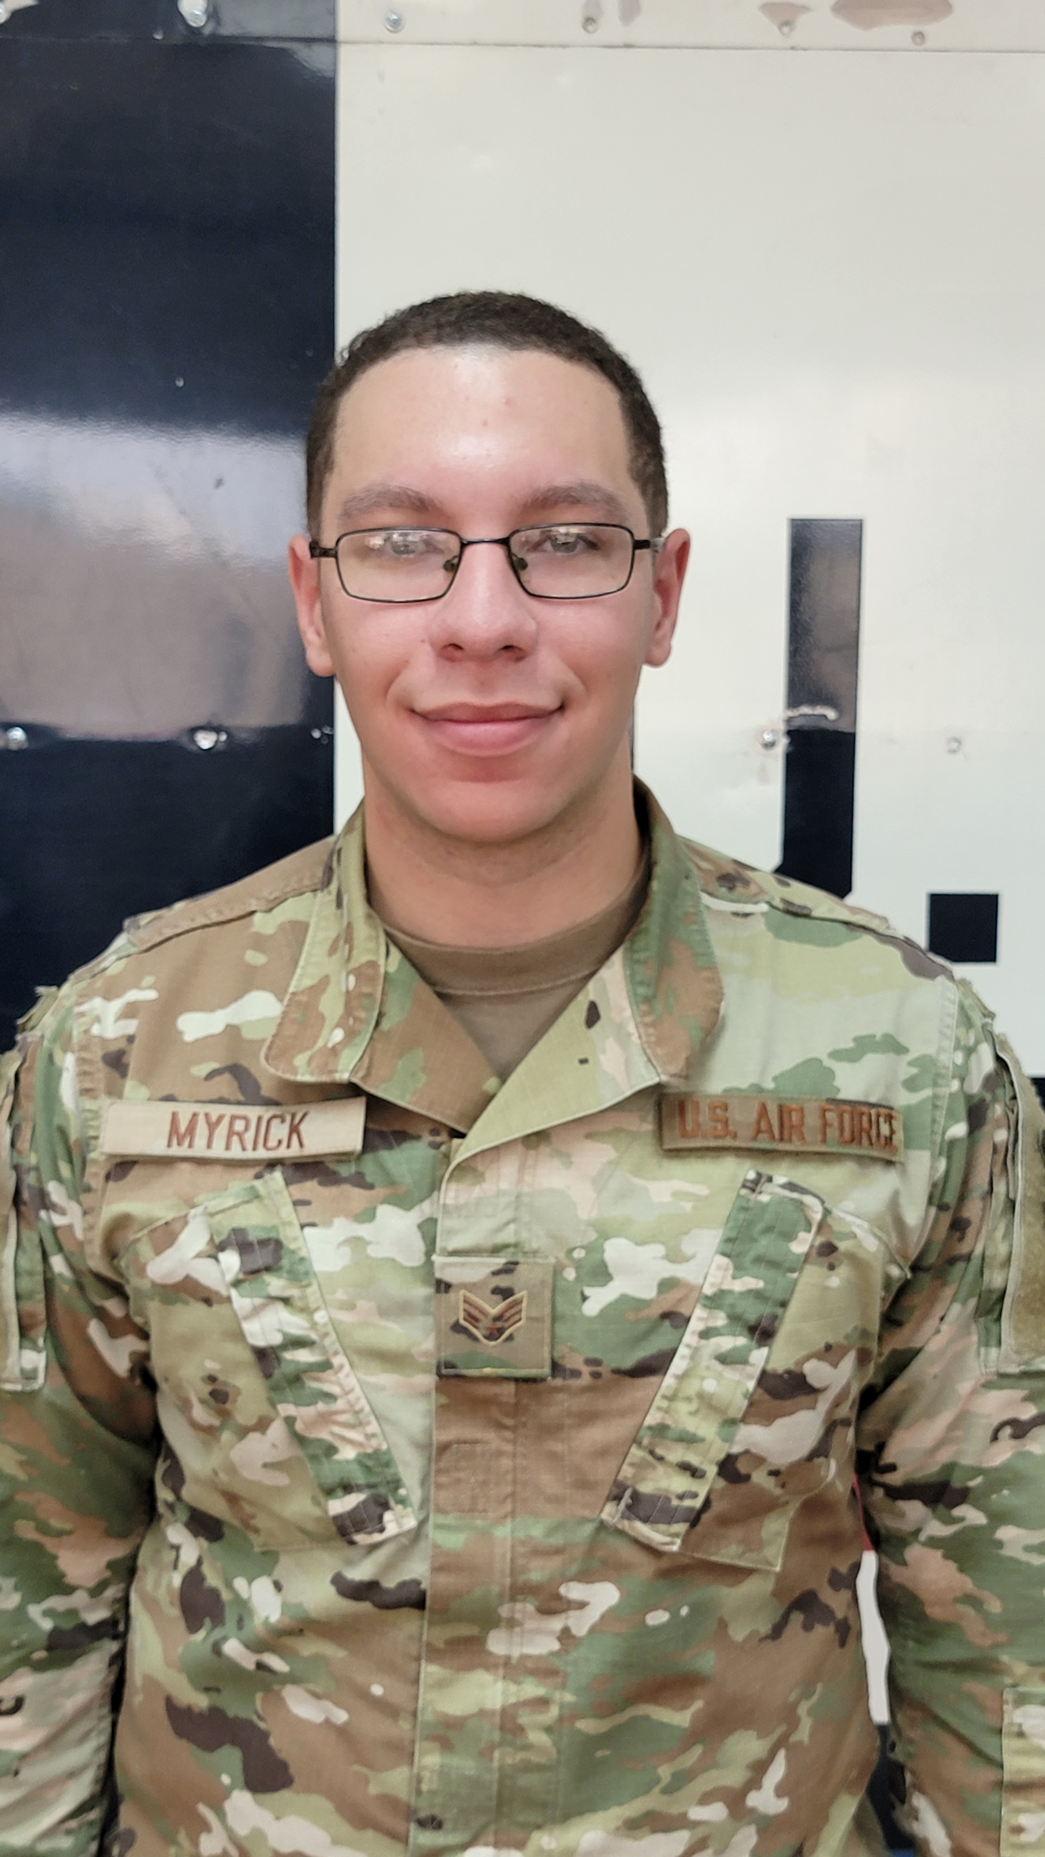
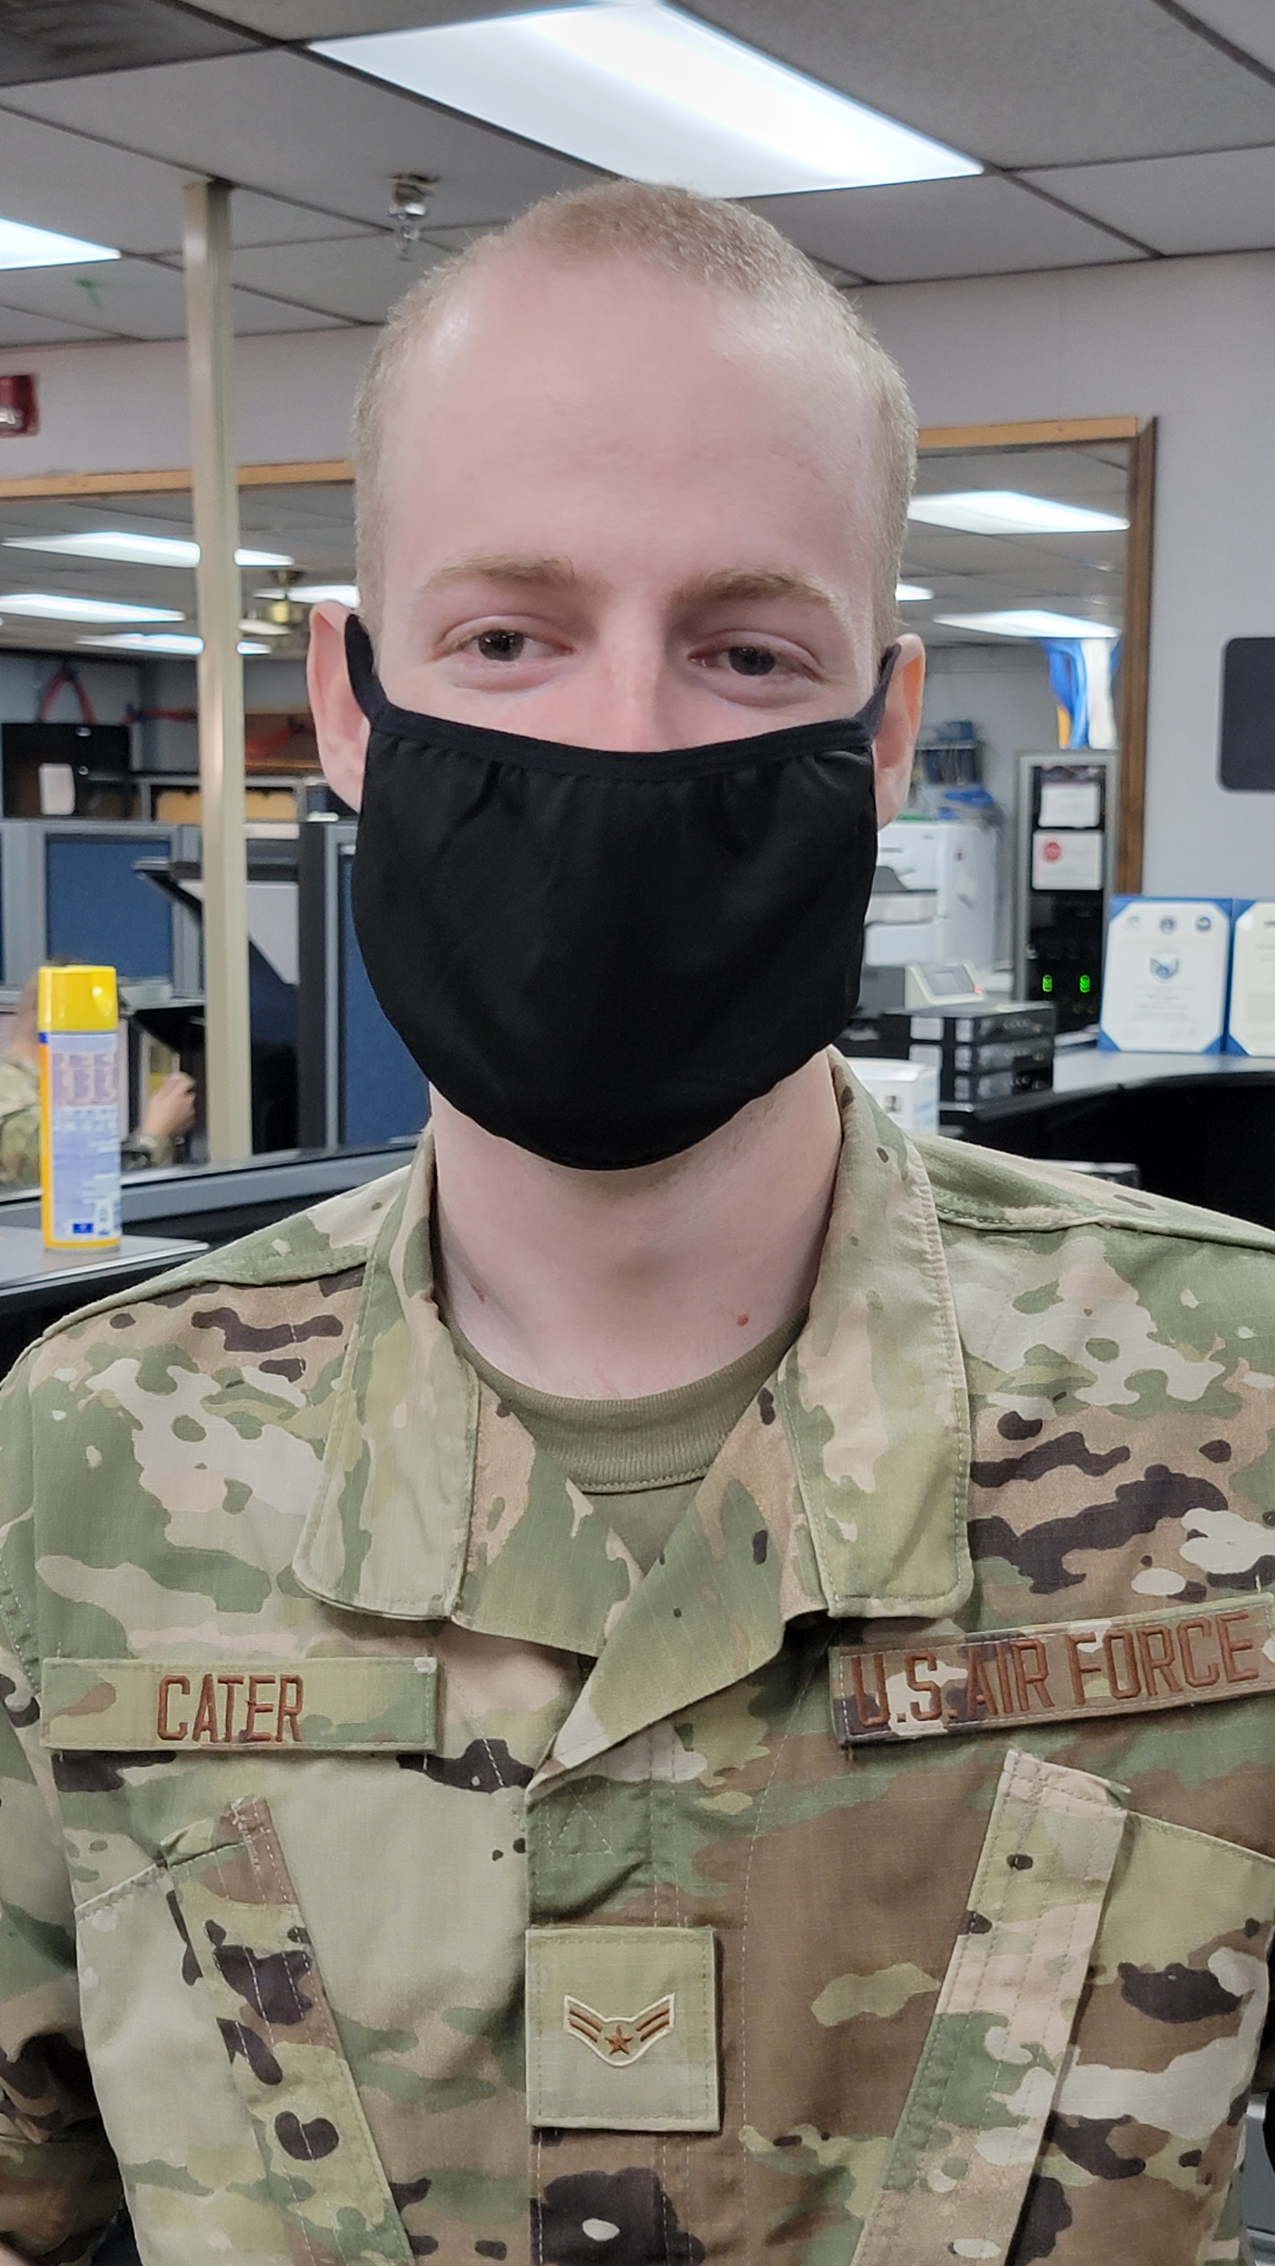
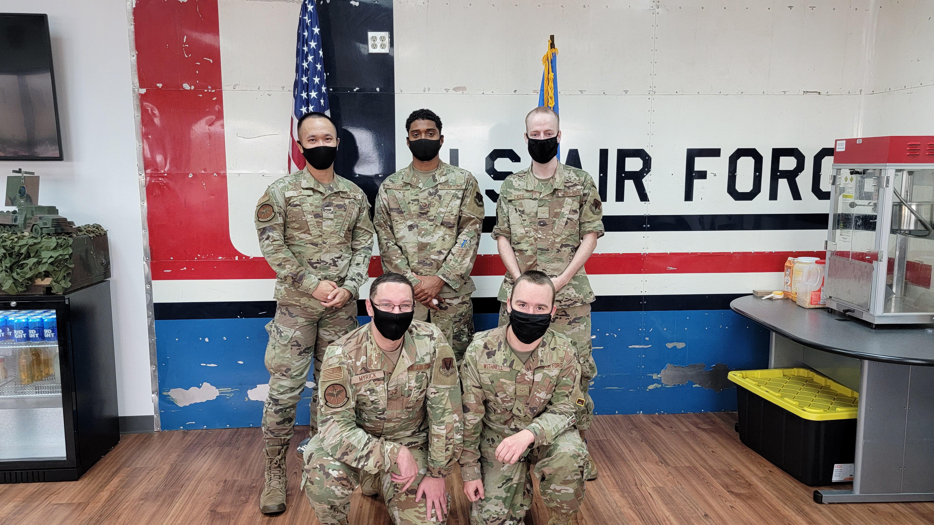
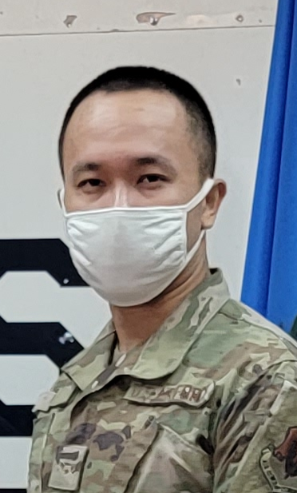
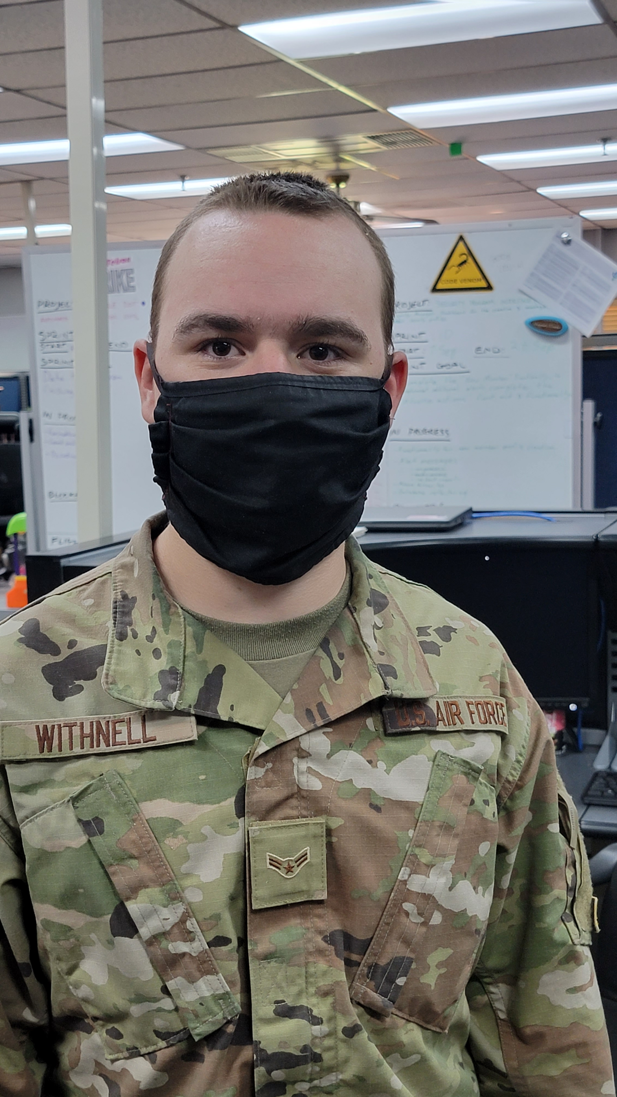
DEPLOYMENT
Deployment options
Local Computer (Dev Laptop) w/o NIPR Access
Requires customer to transfer data via CD
Doesn’t require interim approval
Can be delivered by next week
AO in host Wg
Sim is in contact w/ 72 Wg cybersecurity through auxiliary projects
Can deliver hosting procedures
Migrate to Web
Host via VxRails?
Either React Native / Uno Proj / MAUI / Flutter
Benefits to #3
Same Tech Stack to Mobile Team
Xamarin is deprecating
Interchangeable Teams
Same Training (Xamarin is different than MAUI)
Flexibility on target platform
TEAM
(LEFT)
SrA Stefon Myrick
Product Owner
Interfaces w/ Users
Resolves queries by developers
Loves Chick-Fil-A but hides it from peers
(RIGHT)
A1C Cater
Developer
Resolves EFC stories, created test framework
Has an identical twin
(LEFT)
A1C Sim
Developer
Manages Git Codebase, QC
Ensures User Stories meets criteria
“I’m not squinting at you, I’m just Asian.”
(RIGHT)
A1C Withnell
Developer
Enables front-end testing
Color Codes GUI
Likes puzzles
(TOP)
SSgt Ian Cooper
NCOIC
Handles accountability, interfacing w/ leadership f/ requests.
Learning Developer Duties
Prior Pharmacy Tech

Slide 6
TEAM
(LEFT)
SrA Stefon Myrick
Product Owner
Interfaces w/ Users
Resolves queries by developers
Loves Chick-Fil-A but hides it from peers
(RIGHT)
A1C Cater
Developer
Resolves EFC stories, created test framework
Has an identical twin
(LEFT)
A1C Sim
Developer
Manages Git Codebase, QC
Ensures User Stories meets criteria
“I’m not squinting at you, I’m just Asian.”
(RIGHT)
A1C Withnell
Developer
Enables front-end testing
Color Codes GUI
Likes puzzles
(TOP)
SSgt Ian Cooper
NCOIC
Handles accountability, interfacing w/ leadership f/ requests.
Learning Developer Duties
Prior Pharmacy Tech

